Slide 1
Copyright © 2014 Pearson Education, Inc.

Slide 2
Chapter 6
E-commerce Marketing Concepts: Social, Mobile, Local
Copyright © 2014 Pearson Education, Inc.

Slide 3
Facebook: Does Social Marketing Work?
Have you ever made a purchase based on something you have read or seen on Facebook? What was the product and what made you interested?
What obstacles does Facebook face in monetizing itself as a marketing and advertising platform?
Are there other ways for Facebook to make a profit from marketers and advertisers?
Copyright © 2014 Pearson Education, Inc.
Slide 6-<number>

Slide 4
Consumers Online: The Internet
Audience and Consumer Behavior
Around 75% (89 million) of U.S. households have Internet access in 2012
Growth rate has slowed
Intensity and scope of use both increasing
Some demographic groups have much higher percentages of online usage than others
  Gender, age, ethnicity, community type, income, education
Copyright © 2014 Pearson Education, Inc.
Slide 6-<number>

Slide 5
Consumers Online (cont.)
Broadband vs. dial-up audiences, new mobile audience
Media choices
  Traditional media competes with Internet for attention
  Television viewing has increased with Internet usage
Copyright © 2014 Pearson Education, Inc.
Slide 6-<number>

Slide 6
The Online Purchasing Decision
Stages in consumer decision process
  Awareness of need
  Search for more information
  Evaluation of alternatives
  Actual purchase decision
  Post-purchase contact with firm
Factors that most influence purchasing decision
  Price, free shipping, trusted seller status
Copyright © 2014 Pearson Education, Inc.
Slide 6-<number>

Slide 7
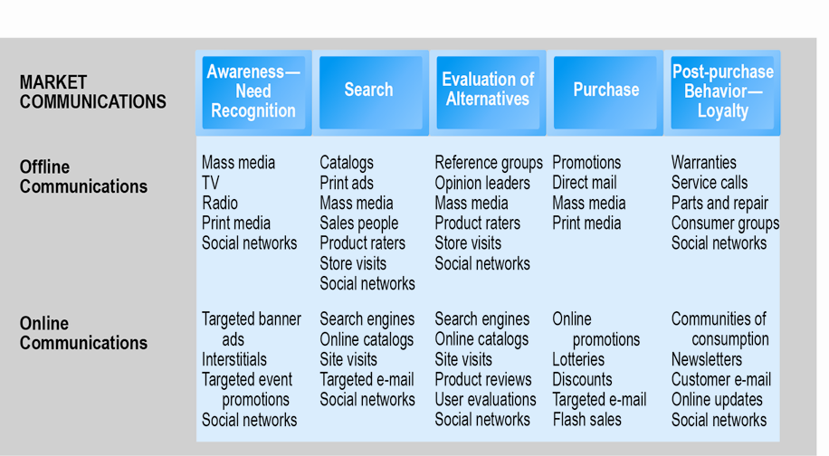
The Consumer Decision Process and
Supporting Communications
Figure 6.1, Page 214
Copyright © 2014 Pearson Education, Inc.
Slide 6-<number>

Slide 8
The Online Purchasing Decision (cont.)
Decision process similar for online and offline behavior
General online behavior model
  Consumer skills
  Product characteristics
  Attitudes toward online purchasing
  Perceptions about control over Web environment
  Web site features: latency, navigability, security
Clickstream behavior
Copyright © 2014 Pearson Education, Inc.
Slide 6-<number>

Slide 9
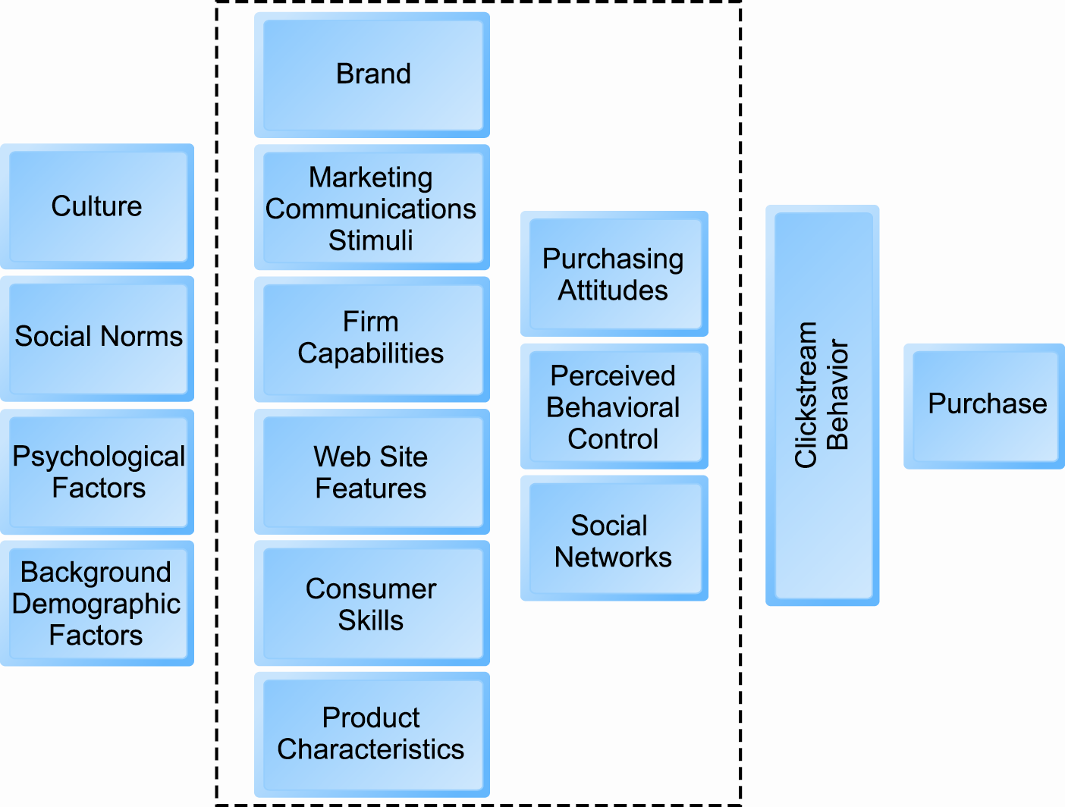
A Model of Online Consumer Behavior
Figure 6.2, Page 215
Copyright © 2014 Pearson Education, Inc.
Slide 6-<number>

Slide 10
Shoppers: Browsers and Buyers
Shoppers: 88% of Internet users
  72% buyers
  16% browsers (purchase offline)
One-third of offline retail purchases influenced by online activities
Online traffic also influenced by offline brands and shopping
E-commerce and traditional commerce are coupled: Part of a continuum of consuming behavior
Copyright © 2014 Pearson Education, Inc.
Slide 6-<number>

Slide 11
What Consumers Shop for and
Buy Online
Big ticket items
  Travel, computer hardware, electronics
  Consumers now more confident in purchasing costlier items
Small ticket items ($100 or less)
  Apparel, books, office supplies, software, etc.
Copyright © 2014 Pearson Education, Inc.
Slide 6-<number>

Slide 12
How Shoppers Find Vendors Online
How shoppers find online vendors
  Search engines—59%
  Marketplaces (Amazon, eBay)—28%
  Direct to retail sites—10%
  Other methods—3%
Online shoppers are highly intentional
Copyright © 2014 Pearson Education, Inc.
Slide 6-<number>

Slide 13
Why More People Don’t Shop Online
Largest factor: trust
  Want to see and touch before buying
  Concerns about financial information
  Delivery costs too high
  Concerns about returning items
Copyright © 2014 Pearson Education, Inc.
Slide 6-<number>

Slide 14
Digital Commerce Marketing and Advertising Strategies and Tools
Internet marketing (vs. traditional)
  More personalized
  More participatory
  More peer-to-peer
  More communal
The most effective Internet marketing has all four features
Copyright © 2014 Pearson Education, Inc.
Slide 6-<number>

Slide 15
Establishing the Customer Relationship
Web site functions to:
  Establish brand identity and customer expectations
    Differentiating product
  Inform and educate customer
  Shape customer experience
  Anchor the brand online
    Central point for all marketing messages
Copyright © 2014 Pearson Education, Inc.
Slide 6-<number>

Slide 16
Online Marketing and Advertising Tools
Basic marketing and advertising tools:
  Search engine marketing
  Display ad marketing
  E-mail and permission marketing
  Affiliate marketing
  Lead generation marketing
  Sponsorship marketing
Copyright © 2014 Pearson Education, Inc.
Slide 6-<number>

Slide 17
Search Engine Marketing and Advertising
$17.6 billion spent in 2012
Types:
  Keyword paid inclusion
  Advertising keywords
  Network keyword advertising or context advertising
Nearly ideal targeted marketing
Copyright © 2014 Pearson Education, Inc.
Slide 6-<number>

Slide 18
Search Engine Marketing and Advertising (cont.)
Social search
  Reviews friends recommendations, searches, Likes, and Web site visits
Search engine issues
  Paid inclusion and placement practices
  Link farms
  Content farms
  Click fraud
Copyright © 2014 Pearson Education, Inc.
Slide 6-<number>

Slide 19
Display Ad Marketing
Banner ads
  May include animation
  Link to advertiser’s Web site
  Can track user
Rich media ads
  More effective than banner ads
  Use animation, sound, and interactivity
Video ads
  In-page commercials before or after content
Copyright © 2014 Pearson Education, Inc.
Slide 6-<number>

Slide 20
Display Ad Marketing (cont.)
Advertising networks
  Sell marketing and advertising opportunities
Ad exchanges
  Establish a real-time bidding process where marketers can bid on ad slots
Copyright © 2014 Pearson Education, Inc.
Slide 6-<number>

Slide 21
E-mail Marketing
Direct e-mail marketing
  Primary cost is purchasing addresses
Spam: Unsolicited commercial e-mail
  Approximately 72% of all e-mail
  Efforts to control spam:
    Technology (filtering software)
    Government regulation (CAN-SPAM and state laws)
Copyright © 2014 Pearson Education, Inc.
Slide 6-<number>

Slide 22
Affiliate Marketing
Firms pay commissions to other Web sites for sending customers to theirs
  Visitors to affiliate site click on ads
  Advertisers pay fee to site
Copyright © 2014 Pearson Education, Inc.
Slide 6-<number>

Slide 23
Lead Generation Marketing
Uses multiple e-commerce presences to generate leads
  Help firms build Web sites, launch e-mail campaigns
  $1.7 billion spent in 2012
Copyright © 2014 Pearson Education, Inc.
Slide 6-<number>

Slide 24
Sponsorship Marketing
Sponsorships
  Paid effort to tie advertiser’s name to particular information, event, and venue in a way that reinforces brand in positive yet not overtly commercial manner
Copyright © 2014 Pearson Education, Inc.
Slide 6-<number>

Slide 25
Social Marketing and Advertising
Fastest growing type of online marketing and advertising
Long-term prospects unknown
Four features driving growth
  Social sign-on
  Collaborative shopping
  Network notification
  Social search (recommendation)
Copyright © 2014 Pearson Education, Inc.
Slide 6-<number>

Slide 26
Social Marketing and Advertising (cont.)
Facebook marketing products
  Facebook pages
  Like button
  Display ads
Twitter marketing products
  Promoted Tweets
  Promoted Trends
  Promoted Accounts
Copyright © 2014 Pearson Education, Inc.
Slide 6-<number>

Slide 27
Social Marketing and Advertising (cont.)
Blog advertising
  72 million read blogs
  Blog readers are ideal demographic
Game advertising
  Both branding and driving customers to purchases in retail stores and restaurants, etc.
  Growing at nearly 50%
Viral marketing
  Customers pass along marketing message via e-mail, social networks, blogs, video and game sites
Copyright © 2014 Pearson Education, Inc.
Slide 6-<number>

Slide 28
Mobile Marketing
7% of online marketing, growing rapidly
Formats include:
  Search
  Display ads
  Video
  E-mail
  Text messaging
  QR codes, couponing
  Games
Copyright © 2014 Pearson Education, Inc.
Slide 6-<number>

Slide 29
Mobile Marketing: Land Rover Seeks Engagement on the Small Screen
Why do mobile devices represent such a promising opportunity for marketers?
Have you ever responded to mobile marketing messages?
What are some of the new types of marketing that mobile devices have spawned?
What the disadvantages of social network marketing?
Copyright © 2014 Pearson Education, Inc.
Slide 6-<number>

Slide 30
App Marketing
Revenue sources
  Pay-per-app
  In-app purchase
  Subscriptions
  Advertising
Most popular types of apps
  Social network, banking, search, news
Retailer’s apps
  Browsing and purchasing
Copyright © 2014 Pearson Education, Inc.
Slide 6-<number>

Slide 31
Local Marketing
Marketing geared to user’s geographic location
Local searches
  20% of all searches
  40% of mobile searches
Most common local marketing tools
  Geotargeting with Google Maps
  Display ads in hyperlocal publications
Copyright © 2014 Pearson Education, Inc.
Slide 6-<number>

Slide 32
Multi-Channel Marketing
Average American spends 24% of media time on Internet, rest on other channels
  Television, radio, newspapers, and magazines
Consumers also multitask, using several media
Internet campaigns strengthened by using other channels
Copyright © 2014 Pearson Education, Inc.
Slide 6-<number>

Slide 33
Multi-Channel Marketing (cont.)
One-to-one marketing (personalization)
  Specific marketing messages to individuals
Interest-based advertising
  Uses online and offline behavior of users to adjust messages
Retargeting ads
  Shows same/similar ads to individuals across multiple sites
Copyright © 2014 Pearson Education, Inc.
Slide 6-<number>

Slide 34
Multi-Channel Marketing (cont.)
Customization and customer co-production
  Changing products according to user preferences
  Co-production—users help create product
Dynamic pricing and flash marketing
  Merchants can change prices on the fly depending on demand
Copyright © 2014 Pearson Education, Inc.
Slide 6-<number>

Slide 35
Long-Tail Marketing
Internet allows for sales of obscure products with little demand
Substantial revenue because
  Near zero inventory costs
  Little marketing costs
  Search and recommendation engines
Copyright © 2014 Pearson Education, Inc.
Slide 6-<number>

Slide 36
The Long Tail: Big Hits and Big Misses
What are “recommender systems”? Give an example you have used.
What is the “Long Tail” and how do recommender systems support sales of items in the Long Tail?
How can human editors, including consumers, make recommender systems more helpful?
Copyright © 2014 Pearson Education, Inc.
Slide 6-<number>

Slide 37
Online Marketing Metrics: Lexicon
Audience size or market share
  Impressions
  Click-through rate (CTR)
  View-through rate (VTR)
  Hits
  Page views
  Stickiness (duration)
  Unique visitors
  Loyalty
  Reach
  Recency
Conversion to customer
  Acquisition rate
  Conversion rate
  Browse-to-buy-ratio
  View-to-cart ratio
  Cart conversion rate
  Checkout conversion rate
  Abandonment rate
  Retention rate
  Attrition rate
Copyright © 2014 Pearson Education, Inc.
Slide 6-<number>

Slide 38
Online Marketing Metrics (cont.)
Social marketing
  Gross rating points
  Applause ratio
  Conversation ratio
  Amplification
  Sentiment ratio
  Duration of engagement
E-mail metrics
  Open rate
  Delivery rate
  Click-through rate
  (e-mail)
  Bounce-back rate
  Unsubscribe rate
  Conversion rate (e-mail)
Copyright © 2014 Pearson Education, Inc.
Slide 6-<number>

Slide 39
How Well Does Online
Advertising Work?
Use ROI to measure ad campaign
Highest click-through rates: Search engine ads, permission e-mail campaigns
Rich media, video interaction rates high
Online channels compare favorably with traditional
Most powerful marketing campaigns use multiple channels, including online, catalog, TV, radio, newspapers, stores
Copyright © 2014 Pearson Education, Inc.
Slide 6-<number>

Slide 40
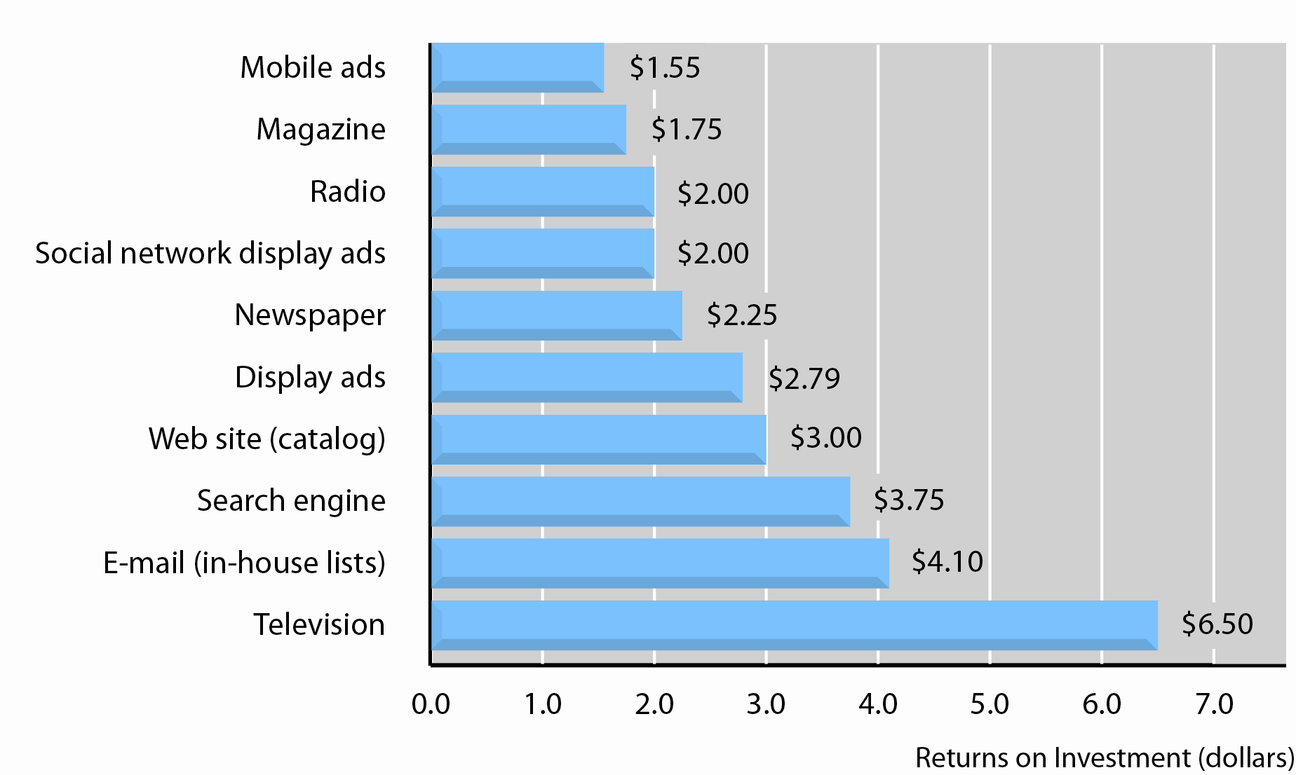
Comparative Returns on Investment
SOURCES: Industry sources; authors’ estimates
Figure 6.9, Page 249
Copyright © 2014 Pearson Education, Inc.
Slide 6-<number>

Slide 41
The Costs of Online Advertising
Pricing models
  Cost per thousand (CPM)
  Cost per click (CPC)
  Cost per action (CPA)
Online revenues only
  Sales can be directly correlated
Both online/offline revenues
  Offline purchases cannot always be directly related to online campaign
In general, online marketing more expensive on CPM basis, but more effective
Copyright © 2014 Pearson Education, Inc.
Slide 6-<number>

Slide 42

Copyright © 2013 Pearson Education, Inc.
Slide 6-<number>

